Slide 1

Building a Java Microservice with CRUD, Docker, K8s, & Monitoring
This presentation covers building a Java microservice with CRUD operations, containerizing with Docker, deploying on Kubernetes, and adding monitoring for reliability.
Learn how to transform your Java application into a resilient, observable service.
ss
By: saurabh sharma

Slide 2
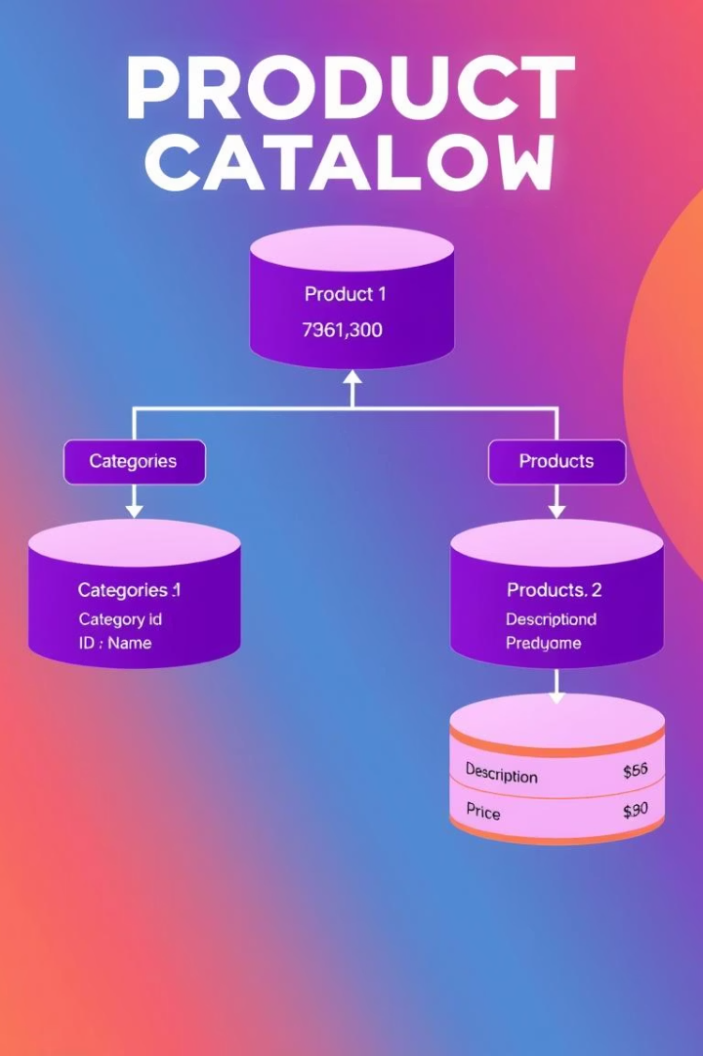
Defining the Microservice & Database Schema
Microservice Purpose
Build a "Product Catalog" service managing products and inventory.
Technology Stack
Spring Boot, MySQL, JPA/Hibernate for ORM and data management.
Database Schema
product_id (INT PK), name (VARCHAR), description (TEXT), price (DECIMAL), quantity (INT).
Spring Initializr
Use dependencies: Web, Data JPA, MySQL Driver.

Slide 3
Building the Java Microservice: Project Setup
Technologies
Project Structure
Dependencies
Spring Boot, Spring Data JPA, and MySQL form the core technology stack.
Model defines data objects
Maven or Gradle manage third-party libraries efficiently.
Repository handles data access
Service encapsulates business logic
Controller manages API endpoints

Slide 4
Implementing CRUD Operations with Spring Data JPA
Entity & Repository
REST Endpoints
Define Product entity annotated for MySQL mapping.
POST /products - Create product
Create ProductRepository extending JpaRepository.
GET /products/{id} - Read product
PUT /products/{id} - Update product
DELETE /products/{id} - Delete product

Slide 5
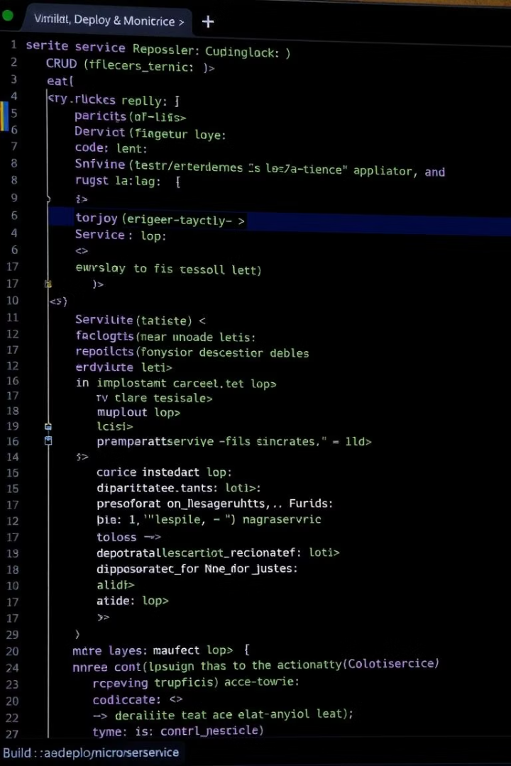
Implementing CRUD Operations with MySQL
Model
Repository
Defines data entities like `Product` with clear fields.
Spring Data JPA simplifies database CRUD interactions.
Service & Controller
Business logic handled by service; REST endpoints are exposed.

Slide 6

Testing and Validation
1
Unit Testing
2
Integration Testing
Mock dependencies and verify individual logic pieces.
Test full system interactions with MySQL database.
3
Validation
Ensure data integrity and handle exceptions gracefully.

Slide 7
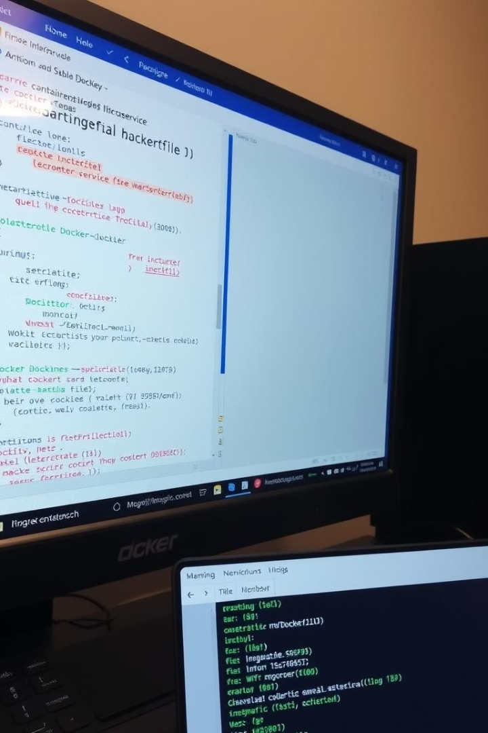
Dockerizing the Application
Create Dockerfile
Specify base image and app dependencies.
Build Image
Use docker build command for creating the image.
Test & Push
Run container locally and push to registry.

Slide 8

Containerizing with Docker
1
Dockerfile Creation
Use OpenJDK base, copy jar, define entrypoint.
2
Build & Run
Build image with `docker build -t product-catalog:latest .`
Run container mapping port 8080.
3
.dockerignore Use
Exclude unnecessary files like `.git` and `target`.
4
Verify Access
Test API endpoints via `localhost:8080` in browser or Postman.

Slide 9
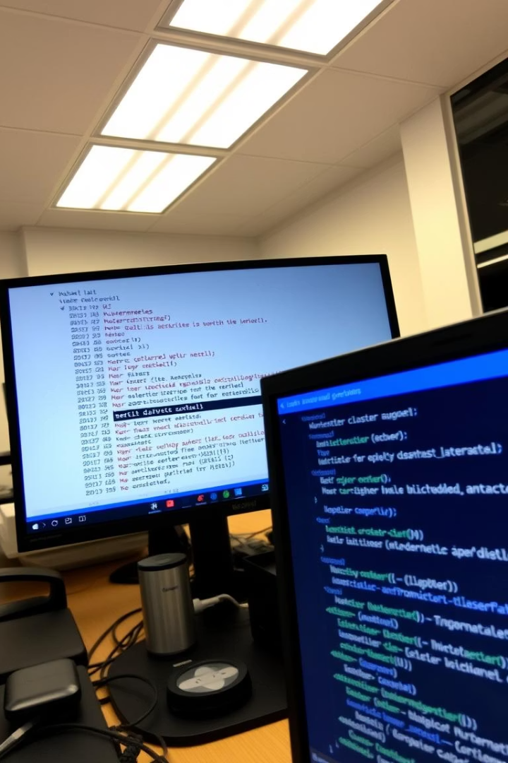

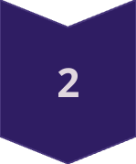

Deploying to Kubernetes (Part 1)
Create YAML Files
Define deployment replicas and service details.
Deploy Application
Apply YAML using kubectl commands.
Expose Service
Use LoadBalancer or NodePort for access.

Slide 10

Deploying to Kubernetes
Deployment YAML
1
Define replicas, container image, and ports.
2
Service YAML
Expose deployment using LoadBalancer or NodePort.
Deploy & Verify
3
Apply manifests with kubectl and check pods/services status.
4
Test Access
Use external IP or NodePort to reach the microservice.

Slide 11
Configuring MySQL in Kubernetes
MySQL Deployment
Environment Variables
Service Connectivity
Data Persistence
Create YAML for MySQL pod, services, and PV for persistence.
Java app connects to MySQL via Kubernetes service endpoint.
Use PersistentVolumes to retain data beyond pod lifecycle.
Set root password and database name securely for container.

Slide 12
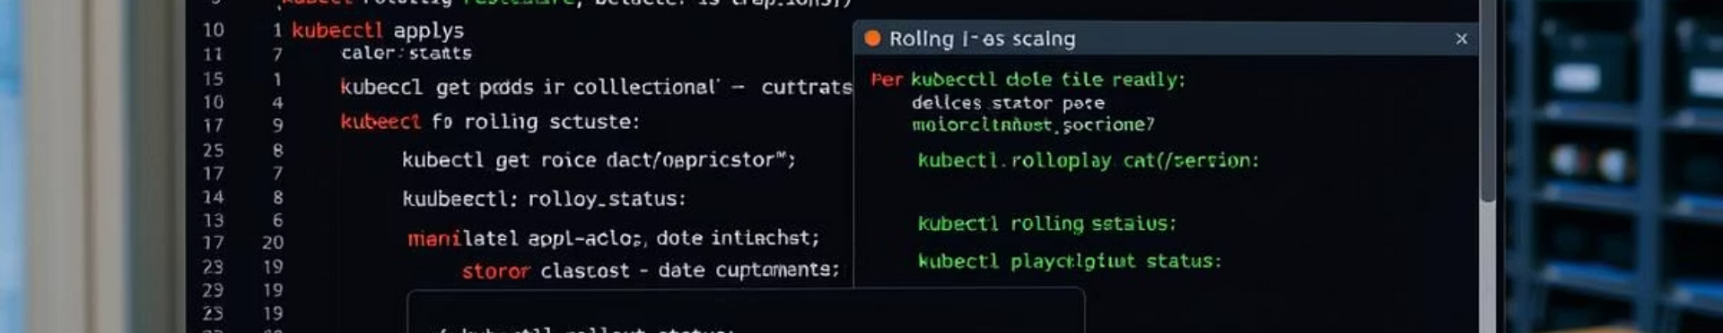
Deploying to Kubernetes (Part 2)
Scale Replicas
Rolling Updates
Health Checks
Adjust deployment size on demand.
Deploy new versions without downtime.
Use liveness and readiness probes for reliability.

Slide 13



Build, Deploy & Monitoring Microservice
Deploy
2
Use Kubernetes to run containers efficiently at scale.
Build
1
Write code, manage dependencies, and containerize application.
Monitor
Collect metrics and visualize with Prometheus and Grafana.
3

Slide 14
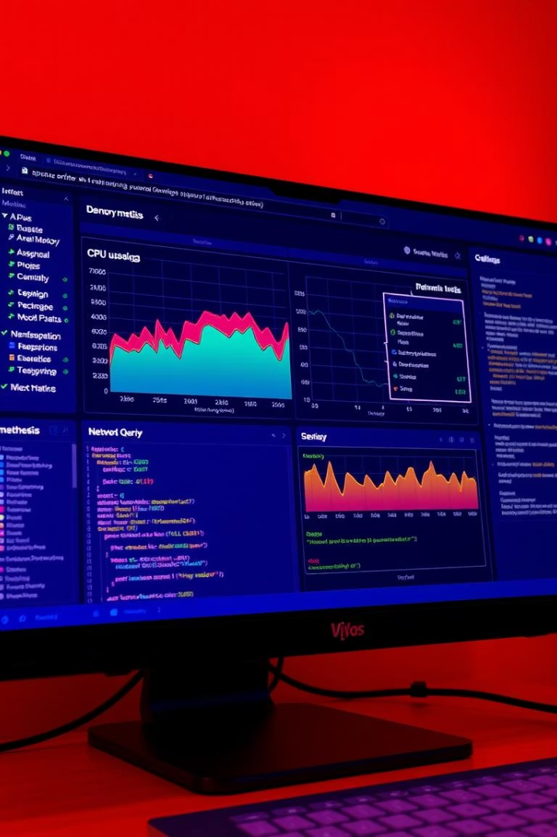
Setting Up Monitoring with Prometheus & Grafana
Deploy Prometheus
Use Helm charts or manifests to run on Kubernetes.
Configure Metrics
Enable /actuator/prometheus endpoint in Java microservice.
Deploy Grafana
Setup Grafana with Prometheus as data source for visualization.
Create Dashboards
Track request latency, error rates, CPU, and memory usage.

Slide 15
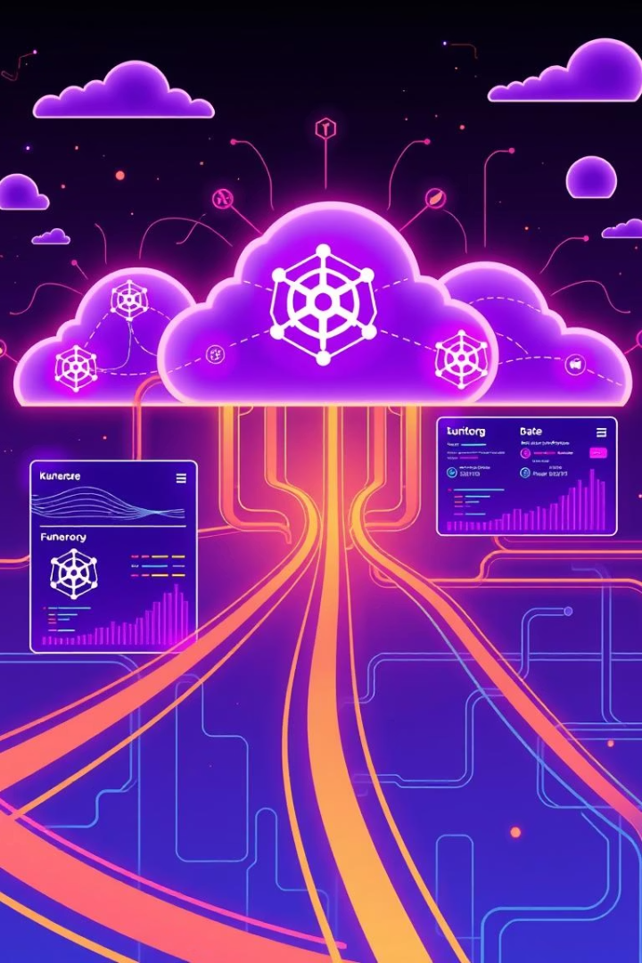
Conclusion & Next Steps
Review Workflow
From Java microservice to Docker, K8s deployment, and monitoring setup.
Enable Scaling
Implement Horizontal Pod Autoscaling in Kubernetes cluster.
Automate CI/CD
Integrate build, test, and deployment automation pipelines.
Enhance Monitoring
Add distributed tracing tools like Jaeger or Zipkin.

